Slide 1
DESIGN CONCEPTS
‹#›

Slide 2
Design
‹#›
Mitch Kapor, the creator of Lotus 1-2-3, presented a “software design manifesto” in Dr. Dobbs Journal. He said:
Good software design should exhibit:
Firmness: A program should not have any bugs that inhibit its function.
Commodity: A program should be suitable for the purposes for which it was intended.
Delight: The experience of using the program should be pleasurable one.

Slide 3
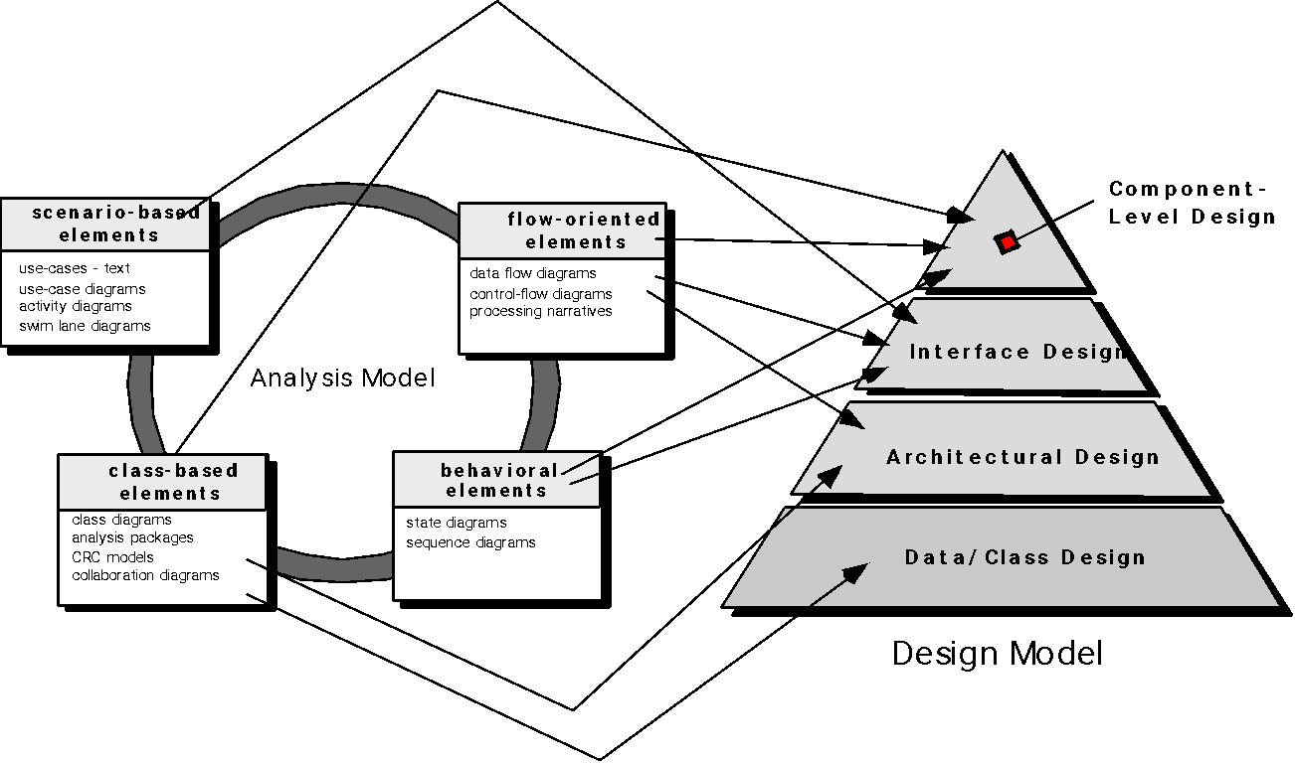
Translating Analysis Model into Design Model
‹#›

Slide 4
Design and Software Quality
‹#›
The design must implement all of the explicit requirements contained in the analysis model, and it must accommodate all of the implicit requirements desired by the customer.
The design must be a readable, understandable guide for those who generate code and for those who test and subsequently support the software.
The design should provide a complete picture of the software, addressing the data, functional, and behavioral domains from an implementation perspective.

Slide 5
Quality Guidelines
‹#›
A design should exhibit an architecture that
has been created using recognizable architectural styles or patterns,
is composed of components that exhibit good design characteristics and
can be implemented in an evolutionary fashion
A design should be modular that is, the software should be logically partitioned into elements or subsystems
A design should contain distinct representations of data, architecture, interfaces, and components.
A design should lead to data structures that are appropriate for the classes to be implemented and are drawn from recognizable data patterns.
* Recognizable Architectures : MVC, Client Server, Layered, Publish-Subscribe etc.

Slide 6
Quality Guidelines (Contd.)
‹#›
A design should lead to components that exhibit independent functional characteristics.
A design should lead to interfaces that reduce the complexity of connections between components and with the external environment.
A design should be derived using a repeatable method that is driven by information obtained during software requirements analysis.
A design should be represented using a notation that effectively communicates its meaning

Slide 7
Quality Attributes
‹#›
Functionality
Usability
Reliability
Performance
Supportability
Maintainability
Extensibility
Adaptability
Serviceability
Testability
Compatibility
Configurability

Slide 8
Design Principles
‹#›
The design process should not suffer from ‘tunnel vision.’
The design should be traceable to the analysis model.
The design should not reinvent the wheel.
The design should “minimize the intellectual distance” between the software and the problem as it exists in the real world.
The design should exhibit uniformity and integration.
The design should be structured to accommodate change.
The design should be structured to degrade gently, even when aberrant data, events, or operating conditions are encountered.
Design is not coding, coding is not design.
The design should be assessed for quality as it is being created, not after the fact.
The design should be reviewed to minimize conceptual (semantic) errors.

Slide 9
Fundamental Design Concepts
‹#›
Abstraction —data, procedure, control
Architecture —the overall structure of the software
Patterns — “conveys the essence” of a proven design solution
Separation of concerns —any complex problem can be more easily handled if it is subdivided into pieces
Modularity —compartmentalization of data and function
Hiding —controlled interfaces
Functional independence —outgrowth of Modularity
Refinement —top-down elaboration of detail for all abstractions
Refactoring —a reorganization technique that simplifies the design
Design Classes —provide design detail that will enable analysis classes to be implemented

Slide 10
Abstraction
‹#›
Abstraction is fundamental way to reduce complexity
Types
Data Abstraction
Procedural Abstraction

Slide 11
Data Abstraction
‹#›
door
manufacturer
model number
type
swing direction
inserts
lights
type
number
weight
opening mechanism
implemented as a data structure

Slide 12
Procedural Abstraction
‹#›
open
details of enter
algorithm
implemented with a "knowledge" of the
object that is associated with enter

Slide 13
Architecture
‹#›
“The overall structure of the software and the ways in which that structure provides conceptual integrity for a system.”
May have one or more of following models
Structural Models
Organized collection of program components
Framework Models
Increase level of program abstraction by identifying repeatable architectural design frameworks encountered in similar type of applications
Dynamic Models
Address behavioural properties of the system
Functional Models
Represents functional hierarchy of a system

Slide 14
Patterns
‹#›
Describes a design structure that solves a particular design problem within a specific context and amid “Forces” that may have an impact on the manner in which the pattern is applied and used.
It must provide a description that enables a designer to determine
Whether pattern is applicable to current work
Whether pattern can be reused
Whether the pattern can serve as a guide for developing a similar but functionally or structurally different pattern.

Slide 15
Patterns
‹#›
Design Pattern Template
Pattern name—describes the essence of the pattern in a short but expressive name
Intent—describes the pattern and what it does
Also-known-as—lists any synonyms for the pattern
Motivation—provides an example of the problem
Applicability—notes specific design situations in which the pattern is applicable
Structure—describes the classes that are required to implement the pattern
Participants—describes the responsibilities of the classes that are required to implement the pattern
Collaborations—describes how the participants collaborate to carry out their responsibilities
Consequences—describes the “design forces” that affect the pattern and the potential trade-offs that must be considered when the pattern is implemented
Related patterns—cross-references related design pattern

Slide 16
Modularity
‹#›
Separation of Concerns
Any complex problem can be more easily handled if it is subdivided into pieces that can each be solved and/or optimized independently
A concern is a feature or behavior that is specified as part of the requirements model for the software
By separating concerns into smaller, and therefore more manageable pieces, a problem takes less effort and time to solve.

Slide 17
Modularity
‹#›
“Modularity is the single attribute of software that allows a program to be intellectually manageable"
Monolithic software (i.e., a large program composed of a single module) cannot be easily grasped by a software engineer.
The number of control paths, span of reference, number of variables, and overall complexity would make understanding close to impossible.
In almost all instances, the design should be broken into many modules, hoping to make understanding easier and as a consequence, reduce the cost required to build the software.

Slide 18
Modularity: Trade-offs
‹#›
What is the "right" number of modules
for a specific software design?
module development cost
cost of
software
module
integration
cost
optimal number
number of modules
of modules

Slide 19
Information Hiding
‹#›
The principle of information hiding suggests that modules be characterized by design decisions that hides from all others.
Information contained in one module should be inaccessible (directly) to other modules.

Slide 20
Information Hiding
‹#›
module
• algorithm
controlled
interface
• data structure
• details of external interface
• resource allocation policy
clients
"secret"
a specific design decision

Slide 21
Why Information Hiding?
‹#›
reduces the likelihood of “side effects”
limits the global impact of local design decisions
emphasizes communication through controlled interfaces
discourages the use of global data
leads to encapsulation - an attribute of high quality design
results in higher quality software

Slide 22
Functional Independence
‹#›
Functional independence is achieved by developing modules with "single-minded" function and an "aversion" to excessive interaction with other modules.
Cohesion is an indication of the relative functional strength of a module. (or the degree to which a module performs one and only one task.)
A cohesive module performs a single task, requiring little interaction with other components in other parts of a program.
Stated simply, a cohesive module should (ideally) do just one thing.
Coupling is an indication of the relative interdependence among modules. ( The degree to which the module is connected to other modules in the system.)

Slide 23
Stepwise Refinement
‹#›
Top-down design strategy
Program is developed by refining levels of procedural details.
It is a process of “Elaboration”.

Slide 24
Refactoring
‹#›
Is a reorganization technique that simplifies design without changing its function or behaviour.
Find
Redundancies
Unused design elements
Inefficient or unnecessary algorithms
poorly constructed or inappropriate data structures
any other design failure that can be corrected to yield a better design.

Slide 25
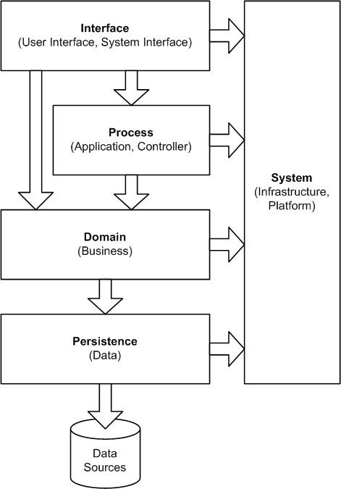
Design Classes
‹#›

Slide 26
Design Classes
‹#›
User interface classes – define abstractions necessary for HCI.
Business domain classes – refinements of analysis classes.
Process classes – implement lower-level business abstractions that manage business domain classes.
Persistent classes – data stores (databases) that persist beyond execution of the software.
System classes – management and control functions that enable the system to operate and communicate within its computing environment and with the outside world.

Slide 27
Characteristics of Design Classes
‹#›
Complete and sufficient – class should be a complete and sufficient encapsulation of reasonable attributes and methods.
High cohesion – class should be focused on one kind of thing.
Low coupling – collaboration should be kept to an acceptable minimum.
Primitiveness – each ‘method’ should be focused on one thing.

Slide 28
END
‹#›

Slide 29
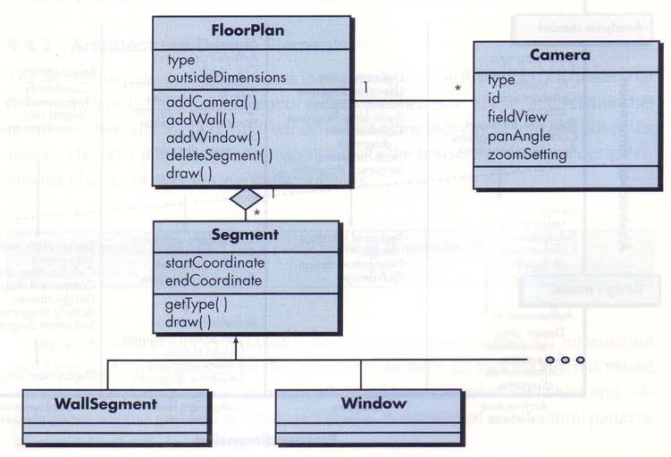
Design class for floor plan
‹#›

Slide 30
The Design Model
‹#›
Can be viewed in two dimensions
Process Dimension – indicates evolution as tasks as executed in software process
Abstraction Dimension – represents the level of details as each elements of the analysis models is transformed into a design equivalent and then refined iteratively.

Slide 31
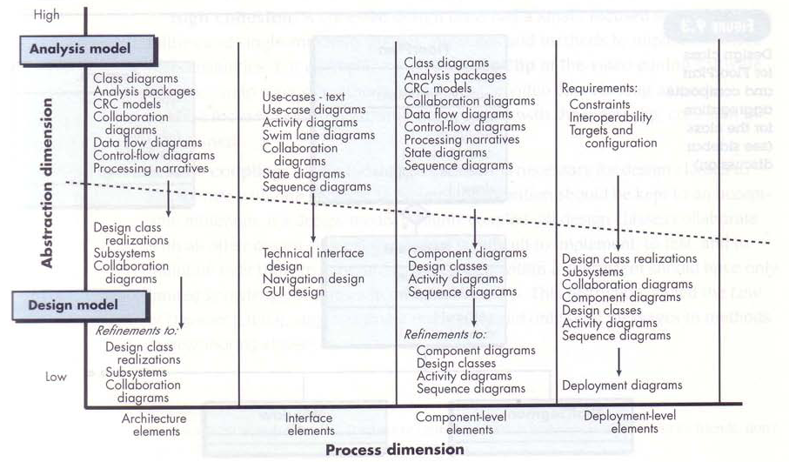
The Design Model
‹#›

Slide 32
Design Model Elements
‹#›
Data elements
Data model --> data structures
Data model --> database architecture
Architectural elements
Information about application domain
Analysis classes, their relationships, collaborations and behaviors are transformed into design realizations
Patterns and “styles”
Interface elements
The user interface (UI)
External interfaces to other systems, devices, networks or other producers or consumers of information
Internal interfaces between various design components.
Component elements
Deployment elements

Slide 33
Architectural Elements
‹#›
The architectural model [Sha96] is derived from three sources:
information about the application domain for the software to be built;
specific requirements model elements such as data flow diagrams or analysis classes, their relationships and collaborations for the problem at hand, and
the availability of architectural patterns (Chapter 12) and styles (Chapter 9).

Slide 34
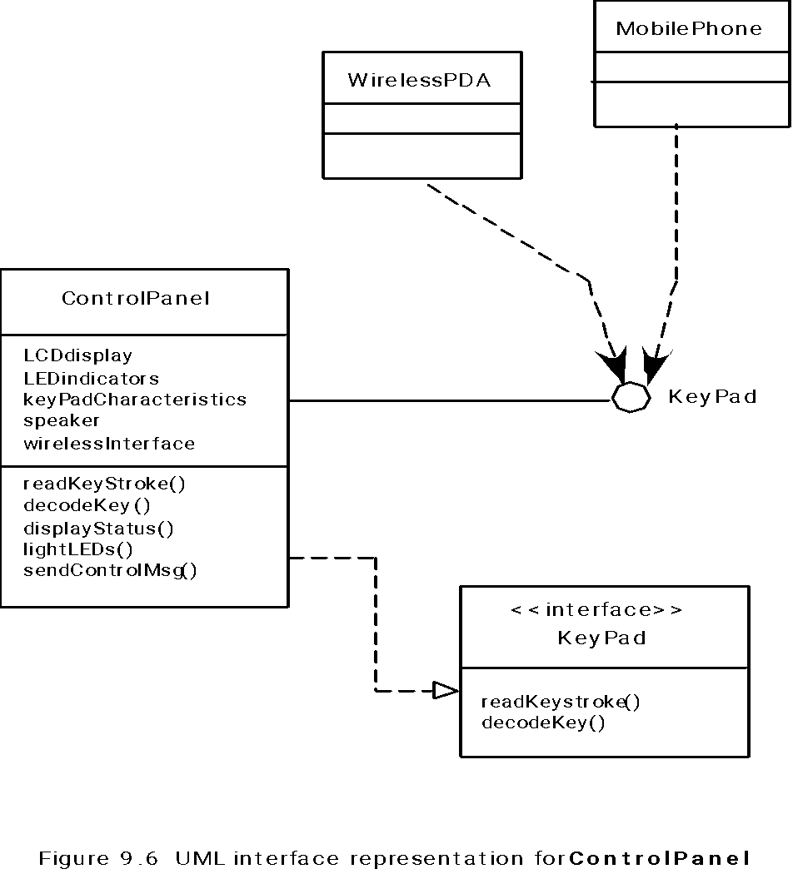
Interface Elements
‹#›

Slide 35
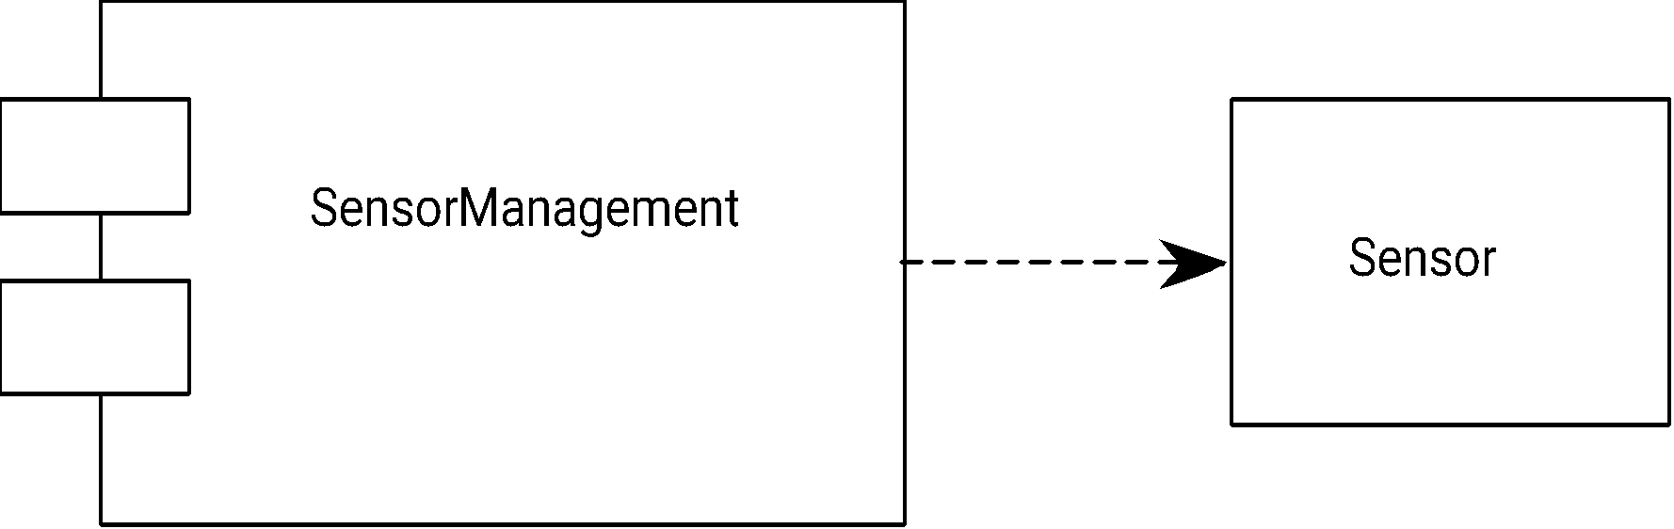
Component Elements
‹#›

Slide 36
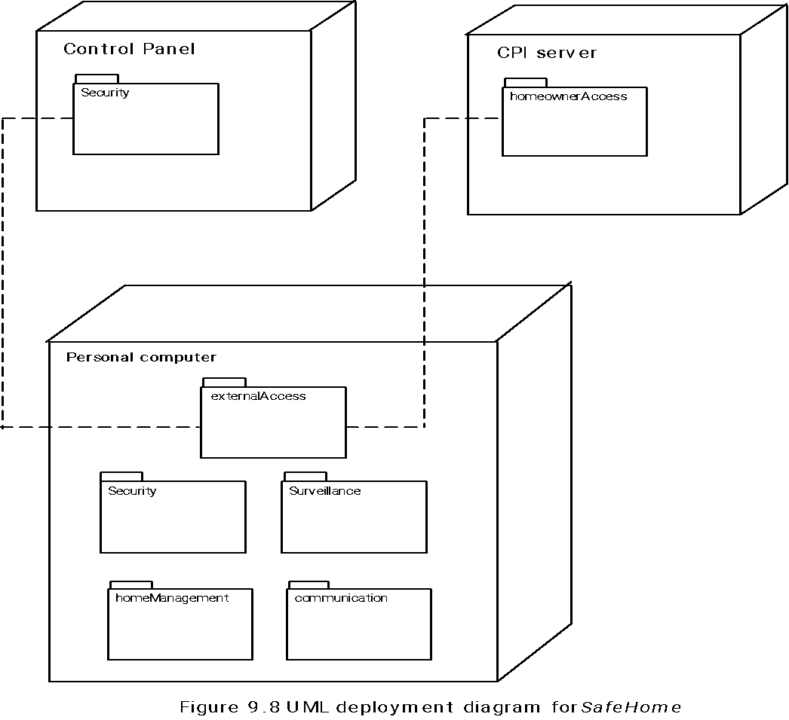
Deployment Elements
‹#›

Slide 37
OO Design Concepts
‹#›
Design classes
Entity classes
Boundary classes
Controller classes
Inheritance—all responsibilities of a superclass is immediately inherited by all subclasses
Messages—stimulate some behavior to occur in the receiving object
Polymorphism—a characteristic that greatly reduces the effort required to extend the design

Slide 38
Design Classes
‹#›
Analysis classes are refined during design to become entity classes
Boundary classes are developed during design to create the interface (e.g., interactive screen or printed reports) that the user sees and interacts with as the software is used.
Boundary classes are designed with the responsibility of managing the way entity objects are represented to users.
Controller classes are designed to manage
the creation or update of entity objects;
the instantiation of boundary objects as they obtain information from entity objects;
complex communication between sets of objects;
validation of data communicated between objects or between the user and the application.

Slide 39
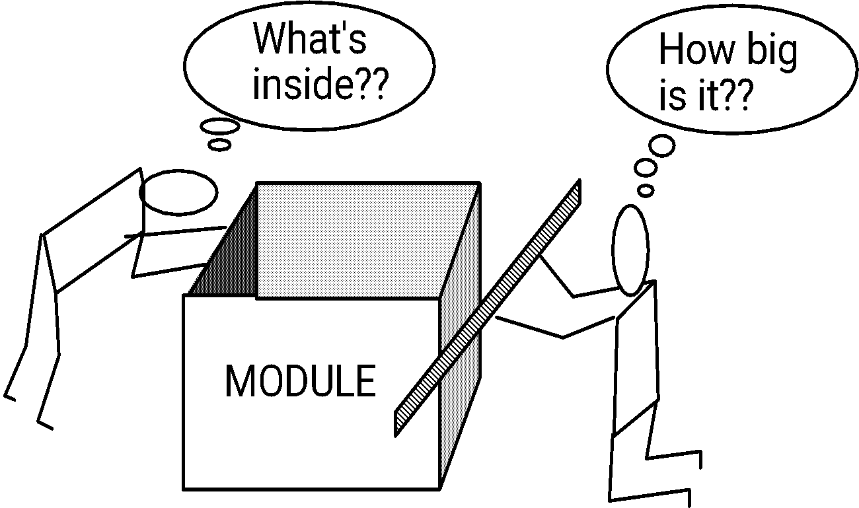
Sizing Modules: Two Views
‹#›

Slide 40
Aspects
‹#›
Consider two requirements, A and B. Requirement A crosscuts requirement B “if a software decomposition [refinement] has been chosen in which B cannot be satisfied without taking A into account. [Ros04]
An aspect is a representation of a cross-cutting concern.

Slide 41
Aspects—An Example
‹#›
Consider two requirements for the SafeHomeAssured.com WebApp. Requirement A is described via the use-case Access camera surveillance via the Internet. A design refinement would focus on those modules that would enable a registered user to access video from cameras placed throughout a space. Requirement B is a generic security requirement that states that a registered user must be validated prior to using SafeHomeAssured.com. This requirement is applicable for all functions that are available to registered SafeHome users. As design refinement occurs, A* is a design representation for requirement A and B* is a design representation for requirement B. Therefore, A* and B* are representations of concerns, and B* cross-cuts A*.
An aspect is a representation of a cross-cutting concern. Therefore, the design representation, B*, of the requirement, a registered user must be validated prior to using SafeHomeAssured.com, is an aspect of the SafeHome WebApp.

Slide 42
Refactoring
‹#›
Fowler [FOW99] defines refactoring in the following manner:
"Refactoring is the process of changing a software system in such a way that it does not alter the external behavior of the code [design] yet improves its internal structure.”
When software is refactored, the existing design is examined for
redundancy
unused design elements
inefficient or unnecessary algorithms
poorly constructed or inappropriate data structures
or any other design failure that can be corrected to yield a better design.

